Slide 1

Food Accessibility in Camden
Kathleen Cruz, Rachel Holloman, Christine Phuong
HCOP National Ambassadors Program

Slide 2

Outline
Purpose
Research
Hypothesis
Experiment
Data
Analysis
Conclusion
HEALTH CAREERS OPPORTUNITY PROGRAM

Slide 3
Camden
Size of the city is 10.39 mi²
Population: 75,550
Nearly 32,000 people live below the poverty line
Annual income is $26,105
Poverty rate is 37.4%
HEALTH CAREERS OPPORTUNITY PROGRAM

Slide 4
Purpose
Camden’s primary problem is its food desert.
Many residents struggle with transportation and money issues.
Residents rely on corner stores that lack the nutrition needed.
Camden only has four supermarkets that sell fresh fruits and vegetables: Cousins Supermarket, Universal Supermarket, Price Rite, and Save A Lot.
The problem is the lack of nutrition that many residents experience and the purpose is to show residents which stores they can go to.
HEALTH CAREERS OPPORTUNITY PROGRAM

Slide 5
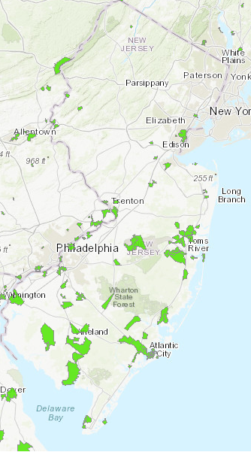
Purpose
What Is a Food Desert?
A food desert is an area where it is
difficult to buy fresh food within a 1-mile radius
from a supermarket.
Residents in food deserts rely on corner stores for
their primary source of food.
Food deserts have the most negative impact
on children and the elderly.
HEALTH CAREERS OPPORTUNITY PROGRAM
Notes:
https://www.hcdnnj.org/foodaccess
This link--->>>> https://www.cdc.gov/pcd/issues/2015/15_0065.htm

Slide 6

Purpose
Sharing our personal experience and why we are so passionate about this project!
HEALTH CAREERS OPPORTUNITY PROGRAM

Slide 7
Research
There are different programs in place that promotes healthy eating in Camden. (Campbell’s Community, Get Healthy Camden, Healthy Corner Store Initiative)
The food map in Camden needed to be updated.
Unhealthy eating seemed to be prevalent in Camden.
The Healthy Corner Store Initiative provides residents with healthier food options at the corner stores.
We learned that the food issues in Camden are more structural related.
HEALTH CAREERS OPPORTUNITY PROGRAM

Slide 8
Hopeworks 2015 Map
https://www.arcgis.com/home/item.html?id=72003c0c8bbe474785abe8b16e313a7a
http://hopeworks.maps.arcgis.com/apps/Viewer/index.html?appid=72003c0c8bbe474785abe8b16e313a7a
HEALTH CAREERS OPPORTUNITY PROGRAM

Slide 9
Hypothesis
While Camden is a community with a great need for food accessibility, there are many organizations and services in place to alleviate this problem. However, connecting residents to these services is often a challenge. Creating a comprehensive guide to accessing food can provide residents with more accessibility to food.
HEALTH CAREERS OPPORTUNITY PROGRAM

Slide 10
Experiment
Deliver the service project
We originally intended to research data based on existing data (Hopeworks, Campbell’s initiative).
We partnered with Hopeworks to update the map.
Our team collected data from the Corner stores in Camden outside the 1-mile radius.
Hopeworks aided us in creating a food accessibility map.
We will have the maps available for Camden residents.
HEALTH CAREERS OPPORTUNITY PROGRAM

Slide 11
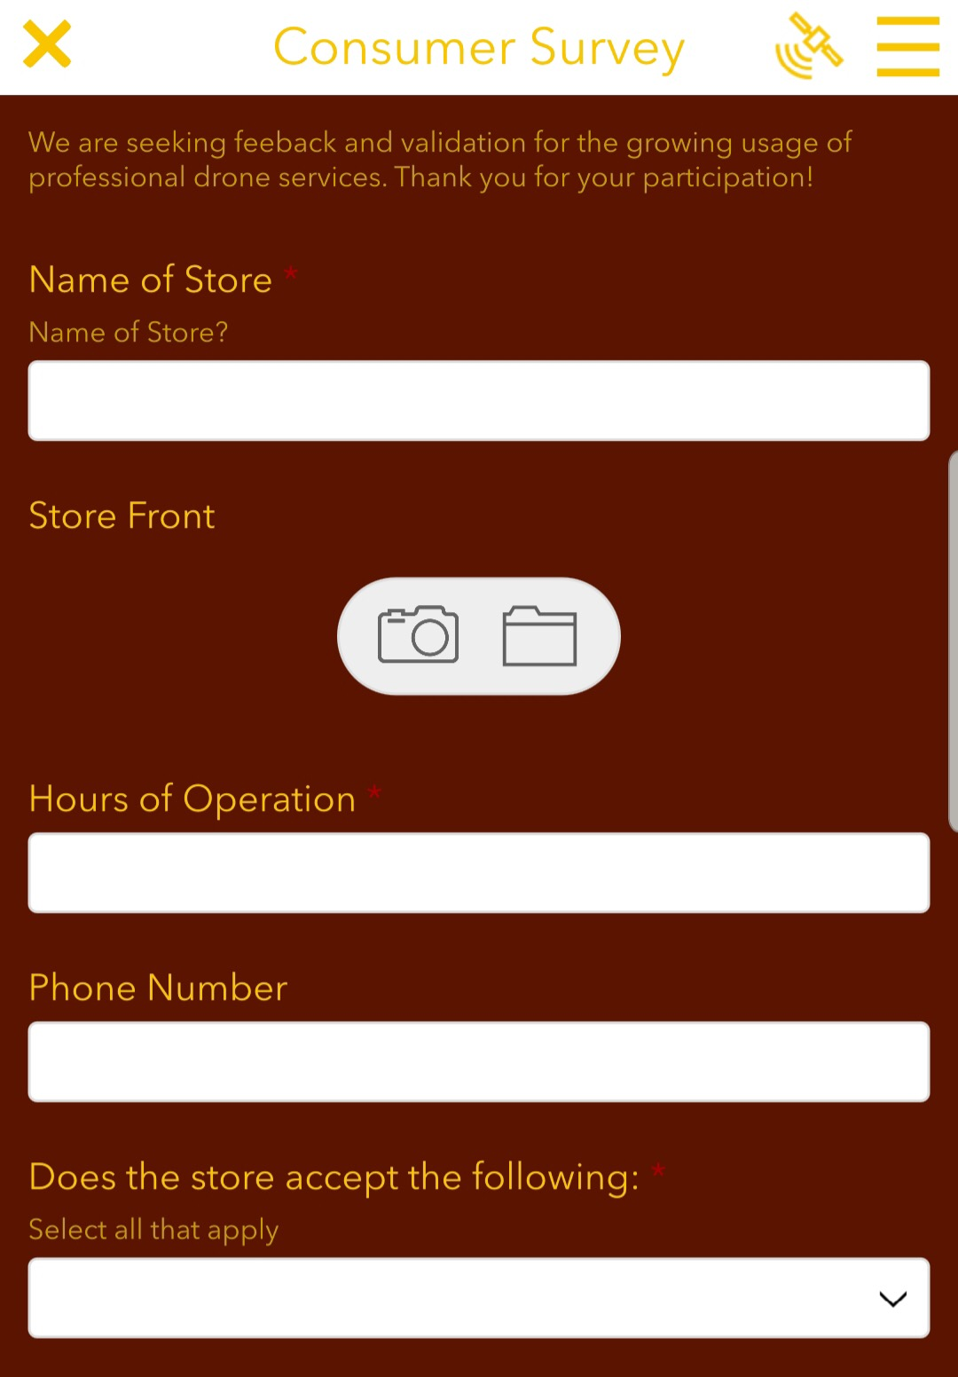
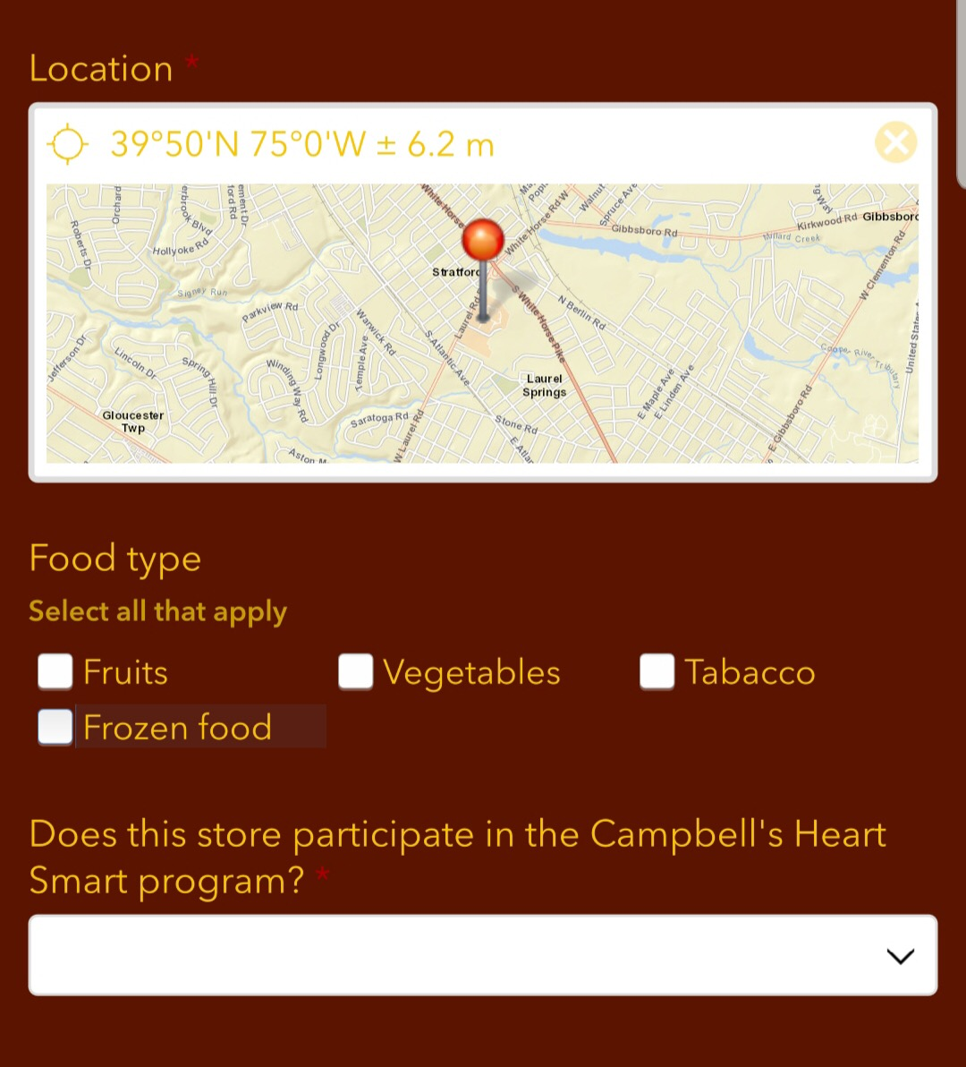
Survey

Slide 12
Data
We collected data from 53 corner stores in Camden.
The data we collected included:
Name
Location
Hours of operation
Telephone number
Was this a healthy corner store? A healthy corner store was determined by the presence of fruits, vegetables, and frozen foods.
If WIC or Food Stamps were accepted
HEALTH CAREERS OPPORTUNITY PROGRAM

Slide 13

Hopeworks-RowanSOM Map
Our HCOP team collected the data for the map.
The Hopeworks team analyzed and cleaned up all the data.
The GIS team at Hopeworks updated the 2015 map using the new data collected by our team.

Slide 14
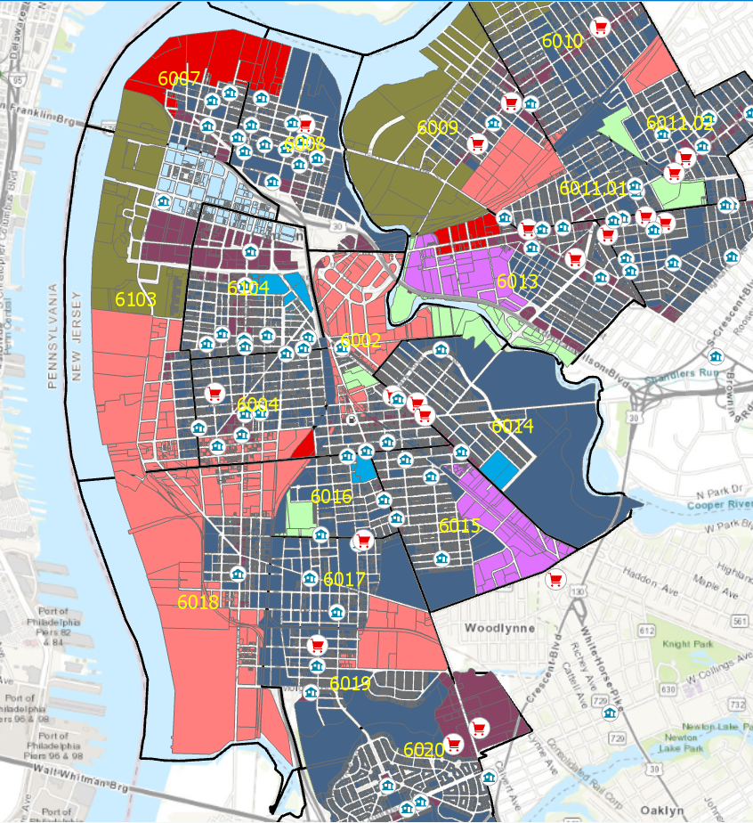
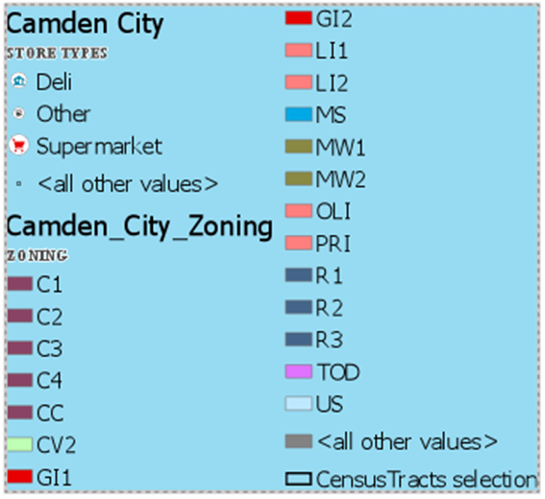
HEALTH CAREERS OPPORTUNITY PROGRAM

Slide 15
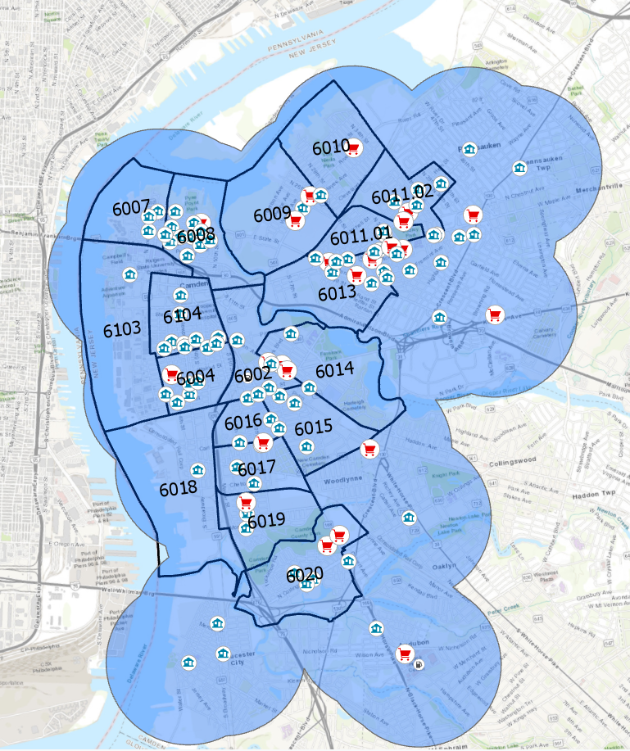

Slide 16
Analysis
Our goals were to create a food map of Camden and distribute this information to the community.
We met our goals for this project, but there is still more work to be done.
As there are many organizations currently doing similar work, the best use of our time and resources was to improve a resource already in place.
We addressed the need that we believed to be necessary for Camden.
HEALTH CAREERS OPPORTUNITY PROGRAM

Slide 17
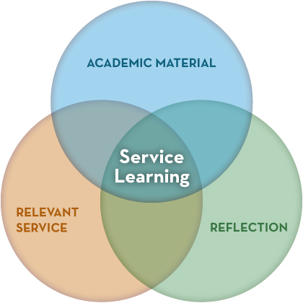
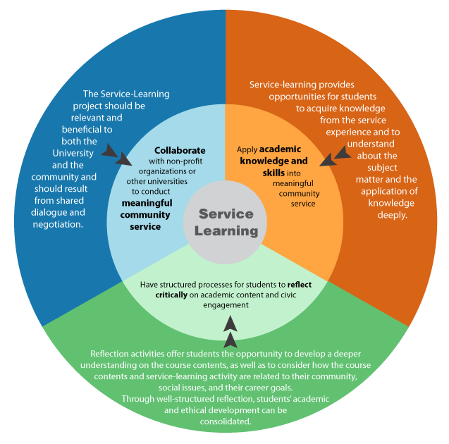
Analysis
Reflecting on our service project
Sharing our thoughts and experience
HEALTH CAREERS OPPORTUNITY PROGRAM

Slide 18
Conclusion
We found that while most of the corner stores had vegetables and fruits, it was limited in varieties and amounts.
We found that the supermarkets were most effective for healthy eating for Camden residents.
The effectiveness of our project depends on the use of the food map by Camden residents.
HEALTH CAREERS OPPORTUNITY PROGRAM

Slide 19
Next Steps
Our next steps will be distributing the map to the residents in Camden.
We hope that this map can be updated every year to show the ongoing problem and to help Camden residents find healthy foods in their neighborhood.
HEALTH CAREERS OPPORTUNITY PROGRAM

Slide 20

Acknowledgments
We would like to thank the following:
Hopeworks
Mary Duggan
Dr. DeLa Cadena
Vanessa Atkins
RowanSOM Diversity Office
HEALTH CAREERS OPPORTUNITY PROGRAM

